Slide 1

Handleiding Night rider
A
B

Slide 2
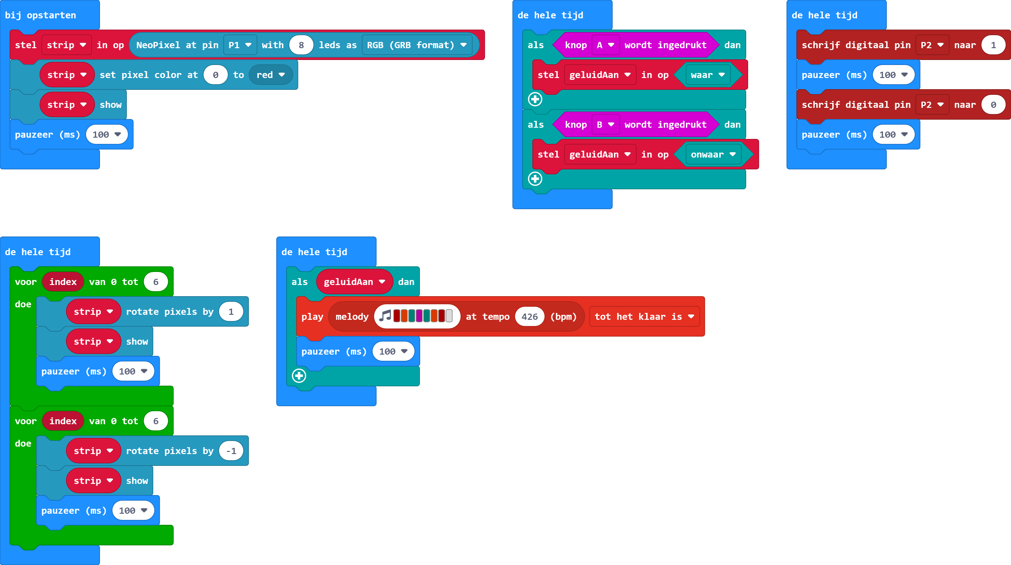

https://makecode.microbit.org/_4Ac7bAD225PF

